Slide 1
WORD PROCESSING

Slide 2
Word processing
A word processor is a software or a device that allows users to create, edit and print documents.
It enables users to write text, store it electronically, display it on a screen, modify it by entering commands and characters from the keyboard and print it.
Of all computer applications, word processing is the most common. Today, most word processors are delivered either as a cloud service or as software that users can install on a PC or other device.

Slide 3
FEATURES OF WORD PROCESSING APPLICATION
Word processors vary considerably, but all word processors, whether cloud-based or installed on a system, support the following basic features:

Slide 4
INTRODUCTION TO MICROSOFT OFFICE
Microsoft Office consists of five core programs: Word, Excel, PowerPoint, Access and Outlook and each program specializes in manipulating different data.
Word manipulates text; Excel manipulates numbers; PowerPoint, manipulates text and pictures to create a slide show; Access manipulates organized, repetitive data such as inventories; and Outlook manipulates personal information such as email addresses and phone numbers.

Slide 5
Introducing the Microsoft Office Ribbons
The basic idea behind the Ribbon interface in Microsoft Office is to store groups of related and commonly used commands (or their icons) under separate tabs.
Although each Office program displays different tabs, the four most common ones are the File tab, the Home tab, the Insert tab, and the Draw tab.
The File tab lets you open, save, and print your files. In addition, the File tab also lets you close a document or customize an Office program through the Options command.
The Home tab displays icons that represent the most common commands for that particular Office program, such as formatting commands.
The Insert tab displays icons that represent common commands for adding items such as pictures and tables to a file.

Slide 6
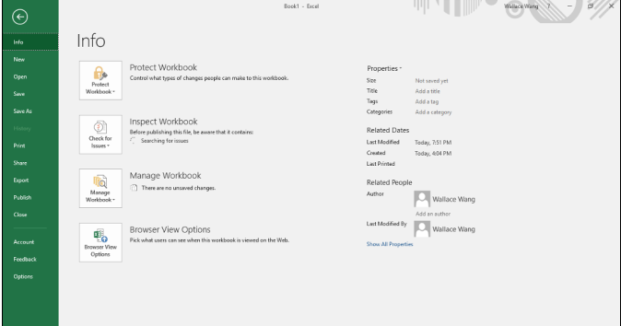
Figure 1: File Tab Options

Slide 7
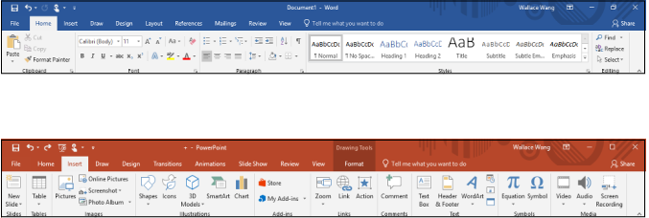
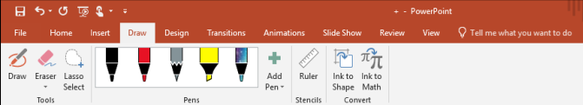
Figure 2: Options for Home Tab
Figure 3: Options for Insert Tab
Figure 4: Options for Draw Tab

Slide 8
Introducing the Microsoft Office Ribbons
In addition to the File, Home, Insert, and Draw tabs, every Office program also includes tabs that contain commands specific to that particular program.
For example, Excel contains a Formulas tab that contains commands for creating a formula in a spreadsheet and PowerPoint contains a Transitions tab for adding transitions to your presentation slide shows.

Slide 9
THE FILE TAB
Some of the various commands available on the File tab follow:
Info: Protects your file from changes, inspects a file for compatibility issues with older programs, and manages different versions of your file. The Info command also lets you view the details of your file, such as the file’s size and the date you created it.
New: Creates a file.
Open: Loads an existing file.
Save: Saves your file. If you haven’t named your file yet, the Save command is equivalent to the Save As command.
Save As: Saves the current file under a new name, or in a different location such as a different folder, or computer, or both.

Slide 10
THE FILE TAB
Print: Prints the current file.
Share: Sends a file as an email attachment or posts it online.
Export: Saves the current file in a different file format.
Close: Closes an open file but keeps the Office program running.
Account: Displays information about a user’s OneDrive account. OneDrive is Microsoft’s cloud computing service that lets you store files online so you can access them from other devices, such as a smartphone, a tablet, or another computer.
Options: Displays various options for customizing the way each Office 2019 program behaves.

Slide 11
CREATING A FILE
In Word, a file is called a document.
In Excel, a file is called a workbook.
In PowerPoint, a file is called a presentation.
In Access, a file is called a database.
Each time you create a file, you have the option of choosing different types of templates that are already formatted and designed for specific purposes, such as a calendar, newsletter, sales report, or corporate slideshow presentation.

Slide 12
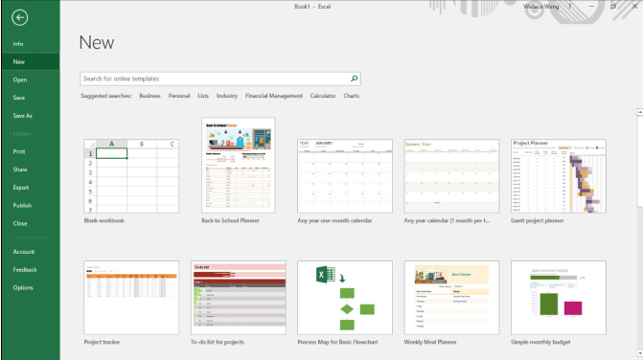
Figure 5: File tab options

Slide 13
CREATING A FILE
To create a file, follow these steps:
Click the File tab.
Click New. A list of templates appears
Double-click the template you want to use. Office creates a file based on your chosen template. Some templates must be downloaded from Microsoft’s website, requiring access to the Internet.
Pressing Ctrl + N is a keystroke shortcut for creating a file.

Slide 14
Opening an existing file
To open a file, follow these steps:
Click the File tab.
Click Open.
An Open pane appears.
Pressing Ctrl + O is a keystroke shortcut for displaying the Open pane.
Choose an option such as Recent or This PC.
If necessary, click the Browse button to access a different folder.
Click the file you want to open.
Your chosen file appears.

Slide 15
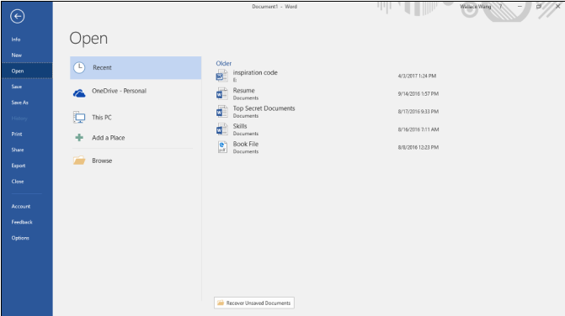
Figure 6: Open tab options

Slide 16
SAVING A FILE
The first time you save a file, you need to specify three items:
The location where you want to store your file.
The name of your file.
The format in which to save your file.

Slide 17
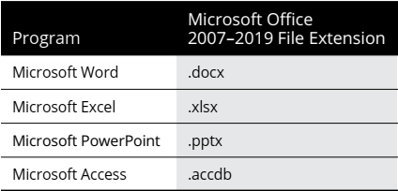
SAVING A FILE
Figure 7: Extensions For Office Applications

Slide 18
WORD PROCESSING
INTRODUCTION TO MICROSOFT WORD

Slide 19
INTRODUCTION
Microsoft word as the name implies is a word processing application used to “process”— format, manipulate, save, print, share — a text-based document.
It is presented in an editable format that allows a user to edit the text by using a number of features. The application was first released in 1983 as Multi-Tool Word.
The first step in using Microsoft Word is finding how to enter text in a Word file.
The name of the non-executable file created using Microsoft word is called a document.

Slide 20
INTRO WINDOW
In modern Microsoft word releases, upon opening the word application, the initial screen or the application window shows three main sections.
A pane that shows recent documents or documents previously created.
A learning section where users can sign in to office and learn more.
A template section that allows a user to choose from a host of templates. This includes just a blank document which is the basic template or other features such as options for flyers, cards resumes, etc.

Slide 21
Using the Basic (blank)Document
Clicking on the blank document template opens up the default word working area.
This area displays the various standard tool bars in every specific document processing application.
The title bar, menu bar, ribbon, quick access toolbar, status bar, document area are some parts of the word application window.

Slide 22
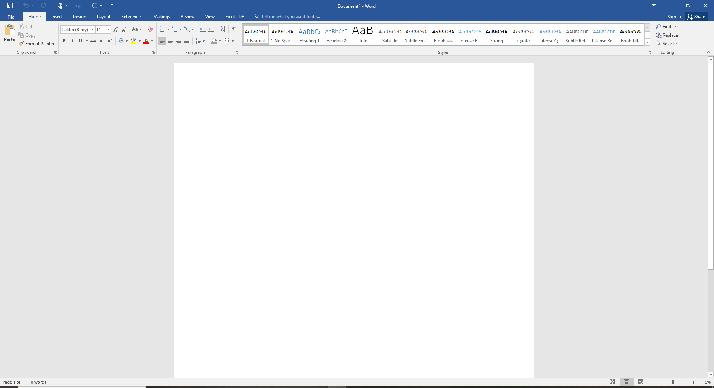
WORD PROCESSING WINDOW
Figure 8: Word Application Window

Slide 23
THE HOME TAB
The home tab is located next to the file tab on the menu bar.
It contains tools for formatting a word document.
The tools are arranged in panels; that is tools that perform similar functions are arranged in a place.
Tools are arranged under clipboard, font, paragraph, styles and editing sections.

Slide 24
THE HOME TAB CLIPBOARD PANEL
The clipboard of a word processing application stores copied data temporarily. It can hold texts, images and they can be pasted into a document.
The cut tool allows a user to remove a selected data from its original position.
The copy tool however creates a duplicate of a selected text from its original.
Once a user cuts or copies, the item copied goes to the clipboard and it stays there until the next restart or until it is overwritten by another data.
The paste tool retrieves the cut or copied item from the clipboard and places it at a user defined area.
The paste special option gives a user more control of how a content is displayed after pasting. It may retain its original formatting or change.
The format painter option copies the formatting of the document and applies it to another.

Slide 25
THE HOME TAB FONT PANEL
This option contains tools for editing a font such as changing the font type, font size, changing letter case, bold, italic and underline.
It also includes options for striking through, subscript and superscript, adding text effects, color highlighting, font color and the ability to clear all formatting.

Slide 26
THE HOME TAB PARAGRAPH PANEL
This contains tools for bulleting and numbering, aligning a document, spacing between lines, indenting documents, sorting, shading and bordering.
The multilevel creates an organized items or create outlines. Place the cursor before a line and press tab to switch point to a sub point. Pressing shift + tab reverses the operation.
Indenting involves moving a paragraph.
Shading changes the background color of a selected text.
Borders add boundaries around a selected text.

Slide 27
THE HOME TAB STYLES
Styles are used to quickly apply a set of formatting choices consistently throughout a document.
These formatting already include pre selected combo of formatting features including font size, color and indentation.
Once applied to a selected text, these styles are applied to the text.

Slide 28
THE HOME TAB EDITTING
The editing panel includes find, replace and select.
The find tool allows a user to search for words in the document by typing a keyword.
Replace allows a user to replace a highlighted word with new word.
The select gives options to select words in the window.

Slide 29
THE INSERT TAB
Next to the home tab is the insert tab.
This also includes about 10 panels of similar tools.
They may include; pages, table, illustrations, add-ins, media, links, comments, header and footer, text and symbols.

Slide 30
THE INSERT TAB PAGES
This allows a user to assign a cover page, a blank page or create breaks in specific portions of a document’s page.
Microsoft word provides a cover page that are templates where users can pick from each of the templates. More templates can be downloaded from Microsoft’s office once a user signs in.
A blank page is created afterwards where a user places the cursor.
Page breaks also breaks a specific page into two parts .

Slide 31
THE INSERT TAB TABLES
Tables can be created in word. They can be created automatically or by specifying number of rows and columns.
An excel spreadsheet can be created in word.

Slide 32
THE INSERT TAB ILLUSTRATIONS
Illustrations allow users to insert pictures, shapes, smart art and present data in the form of charts.
A smart art graphic is a visual representation of information and ideas. There are templates or layout to choose from.
Charts also present data and information graphically. They include popular ones such as histogram, bar chart, pie chart and scatter diagrams.

Slide 33
THE INSERT TAB LINKS
Links allow users to access websites and mail addresses directly from a document.
Links can be created to open local folders on a pc, documents or online websites.
A bookmark in Word works like a bookmark you might place in a book: it marks a place that you want to find again easily. You can enter as many bookmarks as you want in your document or Outlook message, and you can give each one a unique name so they’re easy to identify.
The fastest way to create a basic hyperlink in an Office document is to press ENTER or the SPACEBAR after you type the address of an existing webpage, such as http://www.google.com. Office automatically converts the address into a link.
A cross-reference allows you to link to other parts of the same document. For example, you might use a cross-reference to link to a chart or graphic that appears elsewhere in the document. The cross-reference appears as a link that takes the reader to the referenced item.

Slide 34
THE INSERT TAB HEADER AND FOOTER
Headers help to showcase information such as page number title, author at the top of every page on the document. Word provides templates to pick specific headers from.
Footers perform the same duty as headers except they are placed below every page. They also contain templates and may be used for numbering pages.
Page number allows users to number pages in a word document.

Slide 35
THE INSERT TAB SYMBOLS AND EQUATIONS
Users can choose from a variety of templates of various equations from the options. When a user preferred equation isn’t found, there is an option beneath the list to create a custom equation.
These symbols may include arithmetic, operational, algebraic or scientific.
Placing the cursor at a point allows the user to insert either an equation or a symbol there.

Slide 36
DESIGN
The design tab includes options for formatting mostly the background for every page in a document.
They may include options for adding themes, watermarks and page. color.

Slide 37
LAYOUT
The layout tab allows formatting of a document such as the document orientation, page size, margins, indentation, line spacing and paragraph settings.
It includes the page setup, paragraphing and arrange.

Slide 38
LAYOUT PAGE SETUP
By default, margins are 1 inch from the edge of a sheet. However, if a document requires a different setting for page margins, you can either choose a pre-defined page margin or customize your very own page margin.
Orientation positions a page in either portrait or landscape.
Size allows users to choose specific page or paper types such as letter, A4, A3 or letter. These are mostly predefined before starting to type texts.
Columns divide a specific page into 2, 3 or other equal halves.
Hyphenation allows word to place hyphens automatically at the end of words rather than moving them to the next line.

Slide 39
LAYOUT
The paragraph panels provides specific distances within which indents should be made.
The arrange panel gives users options as to how to position figures in the midst of texts, whether to place figure in front or backwards amongst the texts.

Slide 40
REFERENCES
This tab contains everything about creating table of content.
It involves creating footnotes, citations, captioning table of content and indexing.

Slide 41
FORMAT OF A REPORT
Format of a report refers to the way or overall layout in which a report is made.
Cover Page
Table Of Contents
Body Of Report
BACKGROUND / INTRODUCTION
AIM / OBJECTIVES
SPECIFIC OBJECTIVES
APPARATUS
THEORY
EXPERIMENT

Slide 42
FORMAT OF A REPORT
RESULTS
ANALYSIS OF RESULTS
OBSERVATIONS
DISCUSSIONS
CONCLUSION
RECOMMENDATION
REFERENCES

Slide 43
COVER PAGE
A cover page also referred to as a title page is usually the first page which contains general and basic information such as the topic, name of the author, date of writing report.
It serves the purpose of introducing a work.
For the purpose of this course being geared towards drafting lab reports, a cover page of a typical lab report must contain;
University Name
College
Faculty
Department
Programme
Topic
Author
Date
Signature(optional and may only be appended after a hard copy print out.

Slide 44
Figure 9: Sample Cover Page

Slide 45
CREATING TABLE OF CONTENT
A table of content is an organized listing of a document’s chapters, sections and often figures clearly labelled by page number.
Readers should be able to look at a table of content and understand immediately how a paper is organized.
This enables them to skip to any relevant section or sub-section.
A proper table of content must list all front matter, main content and back matter, including the headings and page numbers of all chapters and the bibliography.
Although a user can create a table of content manually, Microsoft Word enables users to format a table of content automatically.
It is found on a page at the beginning of an academic report. It comes after the title page and ‘’acknowledgement’’ just before the introductory page.

Slide 46
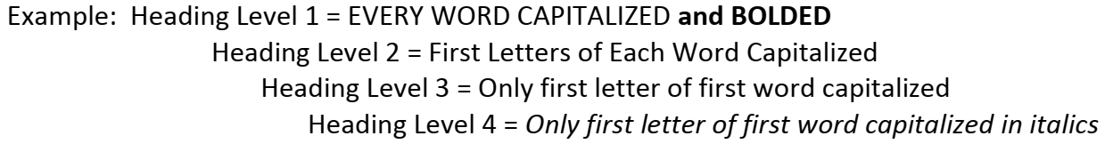
ITEMS INCLUDED IN TABLE OF CONTENT
A table of content includes the title of the paper at the top, followed by the chapter names and subtitles in chronological order.
At the end of each line is the page number of the corresponding headings.
Decide before hand the type and size of the font for each level of the headings. You might want each level to be different or you might want all of the headings to look the same.

Slide 47
ITEMS INCLUDED IN TABLE OF CONTENT
Decide how you want to number the Headings (Titles and sub-titles). Example: 1, 1.1, 1.1.1 and so on. Or 1, 1a, 1.a.1 and so on; Or I, I.1, I.1.1; Or A, A.a A.b and son on; Or A, A.1, A.2, A.2.1 and so on or any other numbering style

Slide 48
CREATING AN AUTOMATIC TABLE OF CONTENT
CREATING AUTOMATIC LISTS OF FIGURES, TABLES AND EQUATIONS
CREATING REFERENCES AND CITATIONS

Slide 49
AUTOMATIC TABLE OF CONTENTS
An automatic Table of Contents uses Styles to keep track of page numbers and section titles for you automatically.
Microsoft Word can scan your document and find everything in the Heading 1 style and put that on the first level of your table of contents, put any Heading 2’s on the second level of your table of contents, and so on.
For an automatic table of contents you need apply the Heading 1 style to all of your chapter titles and front matter headings (e.g. “Dedication” and “Acknowledgements”).
All major headings within the chapters should be use the Heading 2 style. All subheadings should use Heading 3, and so on.

Slide 50
STEPS
Once you have completed the digitization of your document making the decisions suggested above (Font style, size, and Heading style), follow the following easy steps:
Highlight the first Level 1 Heading on the document.
At the “Home” tab, go to the “Styles” Section and click on the “Heading 1” bottom.
Repeat these steps for each heading, indicating its level at the “Styles” Section under the “Home” tab that is, Heading 1 button, or Heading 2 or Heading 3 and so on.
Place the cursor at the beginning of the document.
Click on the “References” tab.
At the “Table of Contents” Section under the “References” tab, click on the “Table of Contents” drop down arrow.
Choose the preferred style.

Slide 51
AUTOMATIC TABLE OF CONTENTS
The table of contents is a snapshot of the headings and page numbers in your document, and does not automatically update itself as you make changes.
At any time, you can update it by right-clicking on it and selecting Update field.
Notice that once the table of contents is in your document, it will turn gray if you click on it.
This indicates that it is getting information from somewhere else.

Slide 52
CAPTIONS
A caption is a numbered label, such as ‘’Figure 1’’, that you can add to a figure, a table, an equation or another object. It is comprised of customized text followed by an ordered number or letter(1, 2, 3… or a, b, c, d…).
It can be optionally followed by some additional, descriptive, text.

Slide 53
ADDING CAPTIONS
Select the object(table, equation, figure or another object) that you want to add a caption to.
On the reference tab, in the captions group, click Insert Caption.
In the label list, select the label that best describes the object, such as a figure or equation. If the list doesn’t provide the label you want, click New Label, type the new label in the label box, then click OK.
Type any text, including punctuation, that you want to appear after the label.
Click OK.

Slide 54
ADDING CAPTION TO FLOATING OBJECT
Insert a figure
Choose layout options and select one of the With Text Wrapping choices.
Add your caption using the steps listed in ‘’add captions’’ above.
Select your caption then hold down the shift key and select your figure.
Right-click on either item and choose Group and select Group.

Slide 55
AUTOMATIC LISTS OF FIGURES, TABLES AND EQUATIONS
If you have captioned your figures, tables, and equations using Word’s captioning feature, you can have Word generate your lists for you automatically.
Place your cursor where you want your list to be.
On the References Ribbon, in the Captions Group, click the Insert Table of Figures icon (even for lists of tables and equations).
In the Table of Figures dialog box, select the label for which you want to make a list from the Caption Label pull down (such as "Equation", "Figure", or "Table").
If you want to change the style of your table of contents (e.g. you want more space between each item in the list), click on the Modify button, select the Table of Figures style, then click the Modify button to do so. Click OK when you are done.
Click OK to insert your table of contents

Slide 56
CITATION AND REFERENCING
Whenever you use information from one source, you’ll need to give them credit by citing them.
Click on the References tab on the top menu. The tool you will be using is Citations & Bibliography.
The first thing you need to do is set the Style to Harvard.
Click on the button to the right of Style.
Select Harvard.
Point the cursor at the point in the document (essay, report or dissertation) where you want to add a citation.
Click Insert Citation.
Click Add New Source.
This opens a Create Source form where you can enter the details of your source.

Slide 57
ADDING REFERENCE LIST
Start by choosing the Type of Source from the drop-down box book, journal, website etc.
Fill in the relevant details in each of the other boxes and click OK.
When you have a list of the sources you wish to include in your work, you can use the referencing tool to automatically generate a Reference List.
On the References tab click Bibliography.
Click on a preferred template and Word will automatically generate a Bibliography for you.

Slide 58
WORD PROCESSING
INTRODUCTION TO MICROSOFT POWERPOINT

